Slide 1

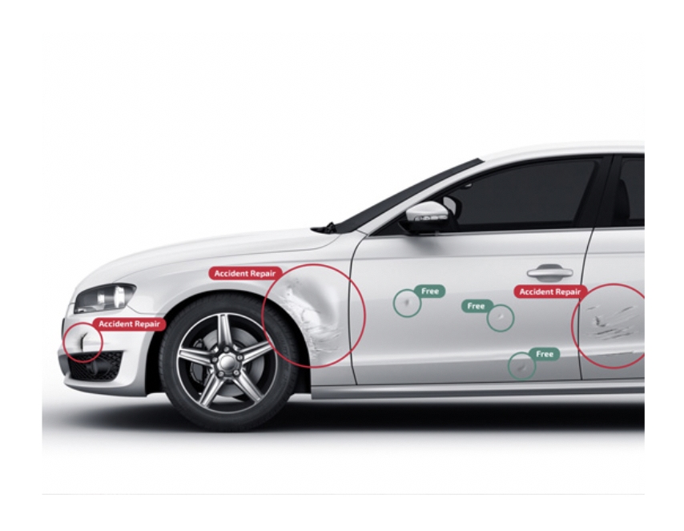
Visual inspection tool
Shardul Nazirkar
Harsh shinde

Slide 2
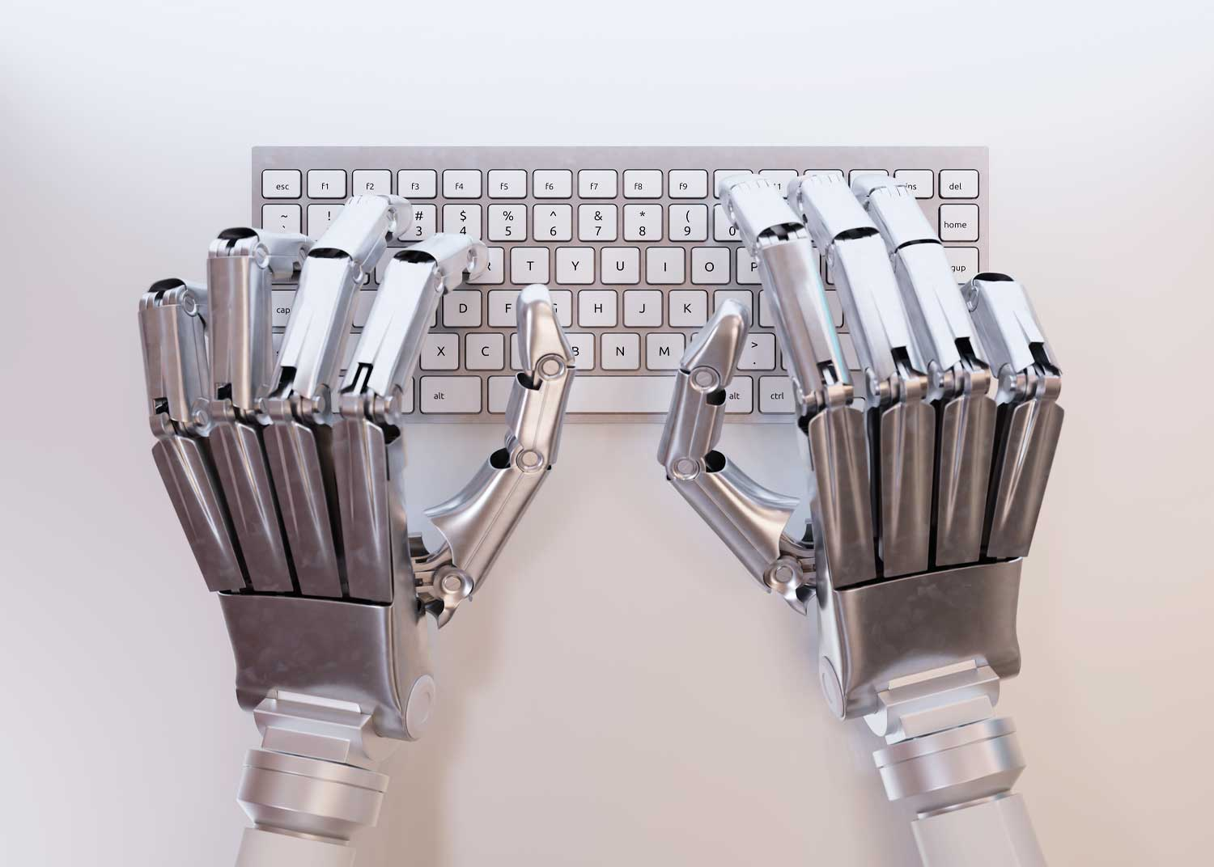
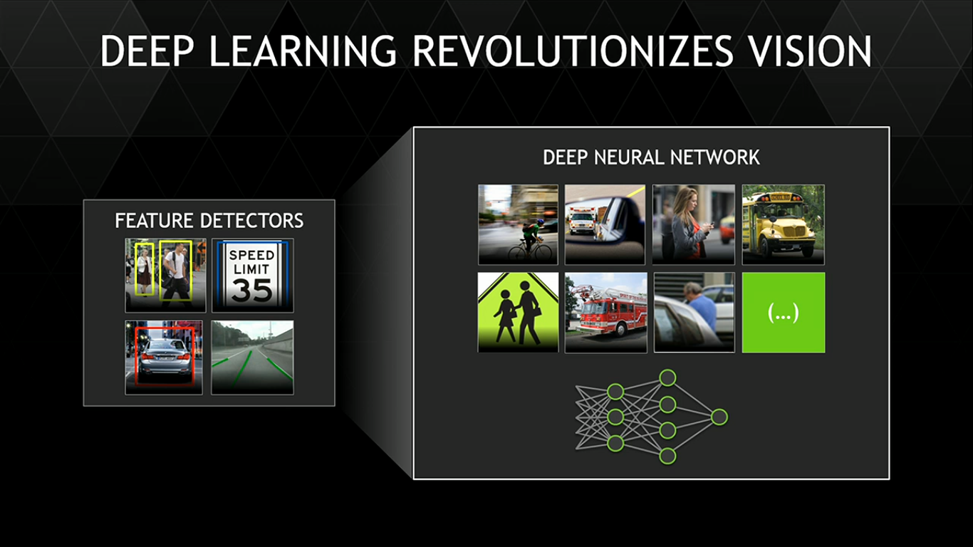
introduction
Artificial Intelligence is turning out to be a game changer, with countless applications in nearly every domain. It is now making its way into the area of Production and Manufacturing, allowing it to harness the power of deep learning and in doing so, providing automation that is faster, cheaper and more superior.
Using Artificial Intelligence along with ML and Deep Learning, we are developing a system that will be used for Visual Inspection in automotive industry and will detect defects, stickers and logos on vehicle surfaces.

Slide 3
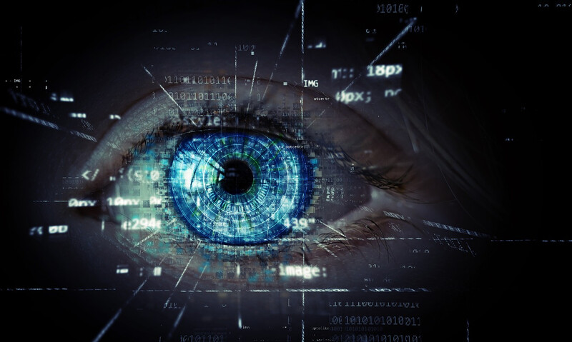
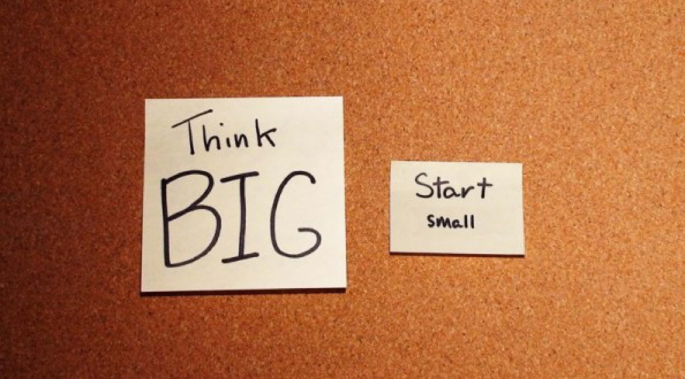


Our philosophy
Focus - In order to do a good job of those things that we decide to do, we must eliminate all of the unimportant opportunities. We strive to give our 100% for the organisation and the project.
Think big — start small - Being ambitious is absolutely crucial. Our team needs an overall vision to keep coming back to day after day and feel like we are contributing and building something big, plus providing a service or product that is genuinely useful and beneficial for people.
Togetherness and Enthusiasm – Together we have the power to solve the seemingly unsolvable problems all the time. Each and every team member complement each other in some way and with the right enthusiasm and interest any problem can be solved.
The dream is free — the hustle is sold separately. - Things don’t just happen. It’s the people who are obsessed with seeing their vision become a reality, and they are willing to put in the work to bring it to life.

Slide 4
Project vision
Design a VISUAL INSPECTION TOOL that detects stickers, scratches and dents on car surfaces for users.
This will help Organisations in tracking their transport resources for identification and any defects.
Develop an end-to-end product that is ready for deployment and scalable for country wide use.
Use latest technologies that can keep up with new shifts and changes in the industry.
Provide after-market support for customization, updation and error/bug-mitigation.

Slide 5
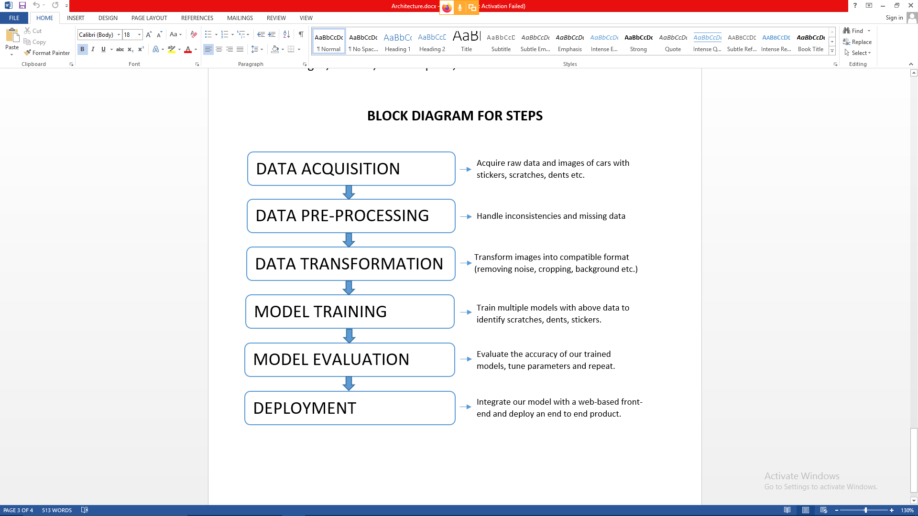
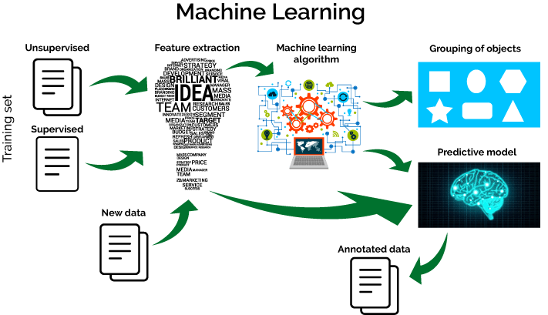
Strategy and execution

Slide 6
Strategy and execution
Steps for Development:
Gather large datasets for model training purposes.
Label Data according to our needs.
Processing data using image enhancement techniques.(eg. remove noise, correct contrast, remove background etc.)
Train different object detection models for each of stickers, number plates, scratches and dents using openCV, TensorFlow etc.
Test our model using testing data and edit and tune it for best accuracy and results.
Testing different models and comparing accuracy results. Finally selecting the best model.
Developing Front-End of the product in Stream-Lit engine and final procedures for product deployment.
Steps during implementation:
Cameras will capture and provide real-time live feed of the car from 4 different angles/views.
System will detect the car from these images and the unnecessary backgrounds and objects will be removed.
The models trained in AI/ML will detect logos, stickers, number plate, scratches and dents on the car images.
Required output will be sent to the user with details about the logos, stickers, number plate, scratches and dents.

Slide 7
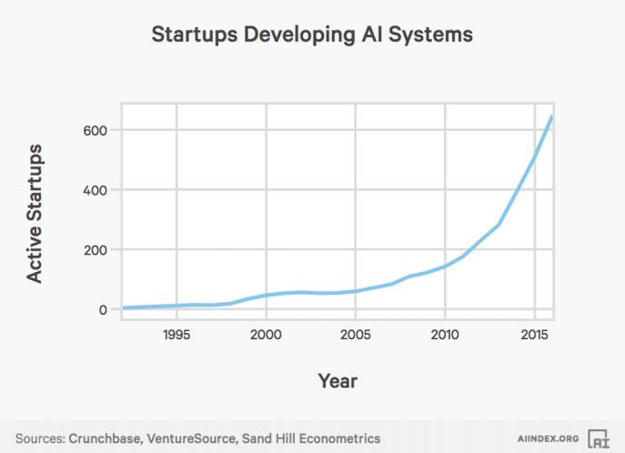
Business impact of AI and deep learning
There has been a 14X increase in the number of active AI startups since 2000:
Crunchbase, VentureSource, and Sand Hill Econometrics were also used for completing this analysis with AI startups in Crunchbase cross-referenced to venture-backed companies in the VentureSource database. Any venture-backed companies from the Crunchbase list that were identified in the VentureSource database were included.

Slide 8
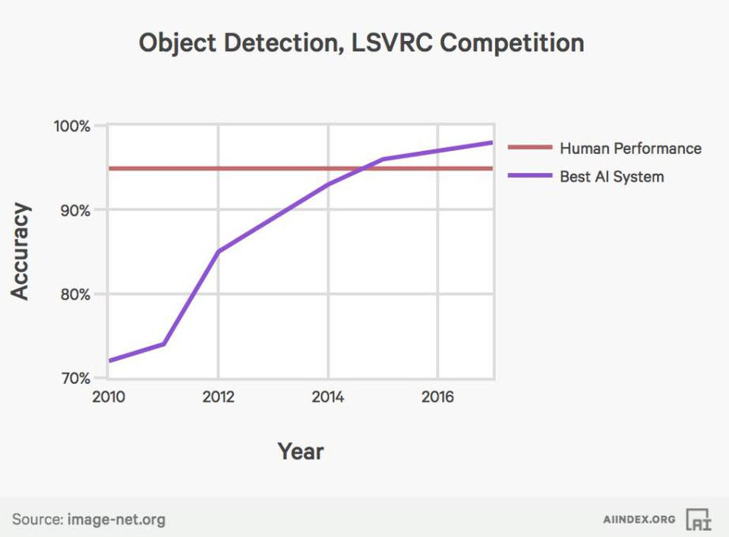
Business impact of AI and deep learning
Error rates for image labeling have fallen from 28.5% to below 2.5% since 2010
AI’s inflection point for Object Detection task of the Large Scale Visual Recognition Challenge (LSVRC) Competition occurred in 2014. On this specific test, AI is now more accurate than human These findings are from the competition data from the leaderboards for each LSVRC competition hosted on the ImageNet website.

Slide 9
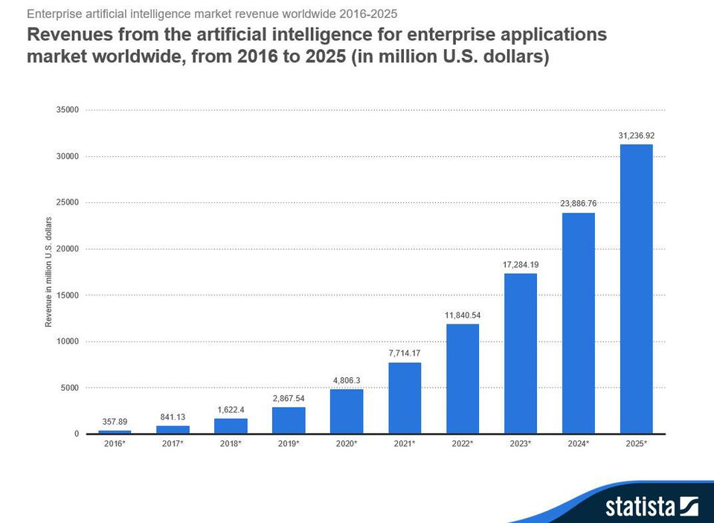
Business impact of AI and deep learning
Global revenues from AI for enterprise applications is projected to grow from $1.62B in 2018 to $31.2B in 2025 attaining a 52.59% CAGR in the forecast period.
Image recognition and tagging, patient data processing, localization and mapping, predictive maintenance, use of algorithms and machine learning to predict and thwart security threats, intelligent recruitment, and HR systems are a few of the many enterprise application use cases predicted to fuel the projected rapid growth of AI in the enterprise. Source: Statista.

Slide 10
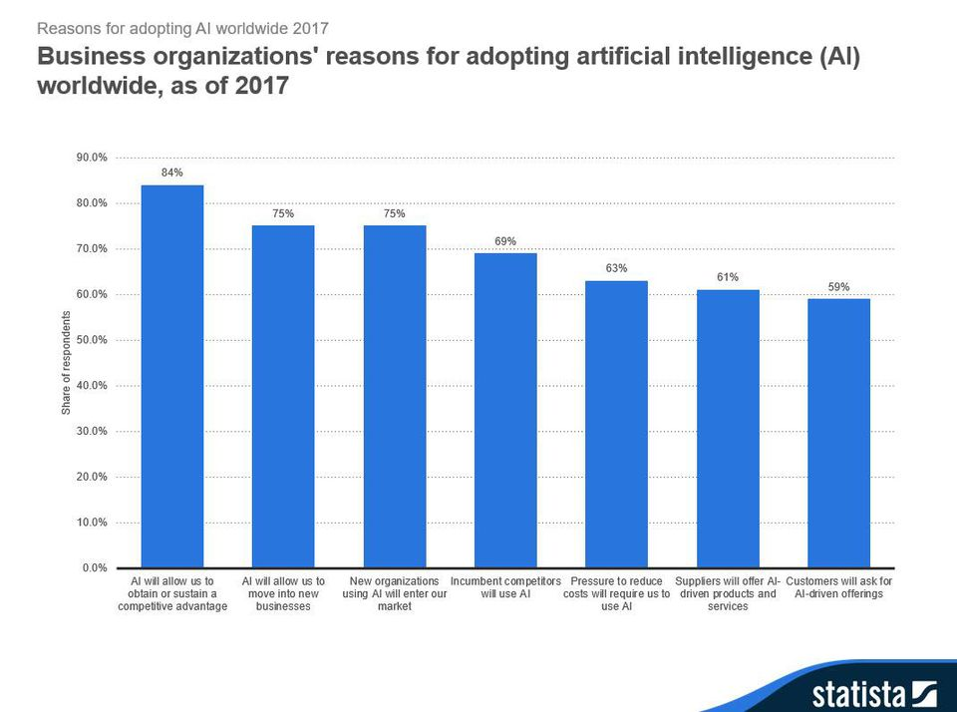
Business impact of AI and deep learning
84% of enterprises believe investing in AI will lead to greater competitive advantages
75% believe that AI will open up new businesses while also providing competitors new ways to gain access to their markets. 63% believe the pressure to reduce costs will require the use of AI. Source: Statista.

Slide 11
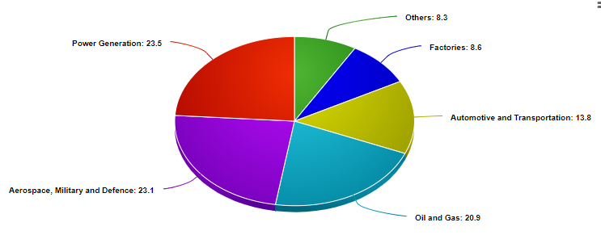
Business impact visual inspection tool in industries
Among the many industries where visual inspection is required, there are several where visual inspection is considered to be of very high consequence and is high priority activity due to the potentially high cost of any errors that may arise via inspection such as injury, fatality, loss of expensive equipment, scrapped items, rework, or a loss of customers. Such fields where visual inspection is prioritized include nuclear weapons, nuclear power, airport baggage screening, aircraft maintenance, food industry, medicine and pharmaceuticals.

Slide 12

Business impact visual inspection tool in industries
Cost of labour
Manual inspection remains a costly venture due to the appointment of (multiple) trained individuals. Cost-wise, manual inspection operators may be earning a yearly salary of $50,000 to $60,000.

Slide 13
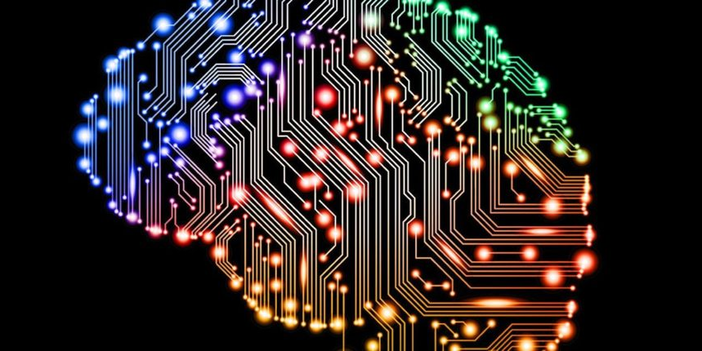
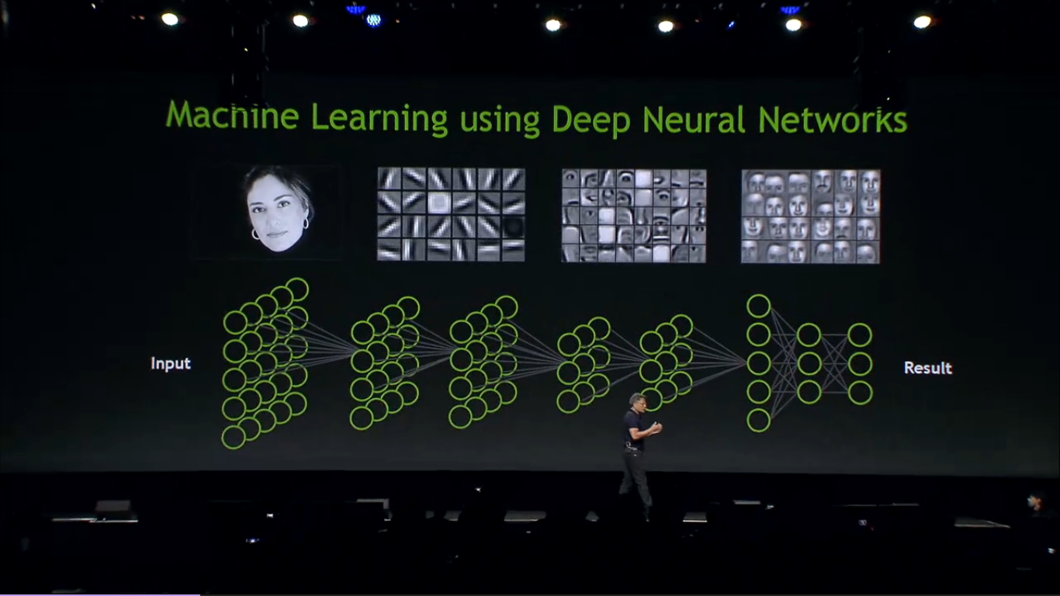
Technologies
Artificial intelligence (AI) technology is increasingly focused on object detection technology, notably in the field of computer vision. This ground-breaking technology has been years in the making.
Object detection was an extremely difficult problem to solve, but with advancements and breakthroughs in Machine Learning concepts especially with DEEP LEARNING using Neural Networks we have come a long way and the accuracies have sky-rocketed.

Slide 14


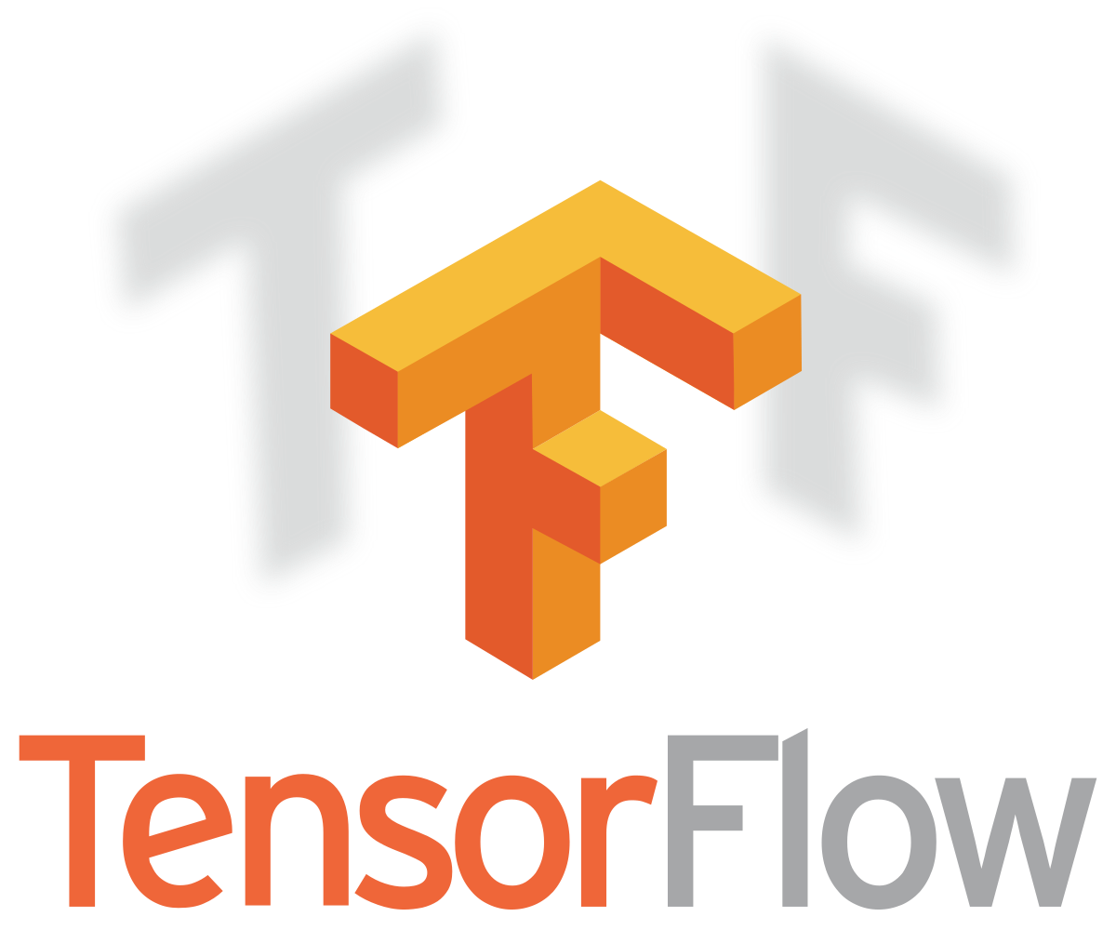


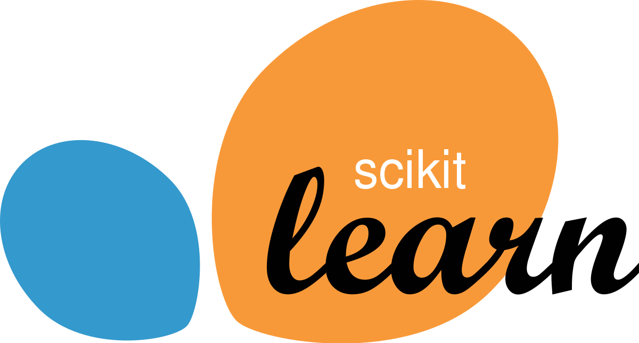
technologies
Main Programming Environment – Python (basic libraries like Numpy, Pandas & Matplotlib)
Image Recognition & Processing – OpenCV (Open Source Computer Vision Library)
ML & Deep Learning CNN – TensorFlow, Keras, Scikit-Learn
Front-End – Web-based using Stream-Lit Engine library
Database – MySQL

Slide 15
THANK YOU

